Slide 2
The first people to inhabit New Zealand were the Māori people.
The Māori people travelled the seas in huge canoes.
They used the sun, stars and currents of the sea
to navigate the waters and find land.
They arrived in New Zealand some time between 1200-1300AD.
Before this, New Zealand was known as ‘The Land of the Long White Cloud’.

Slide 3
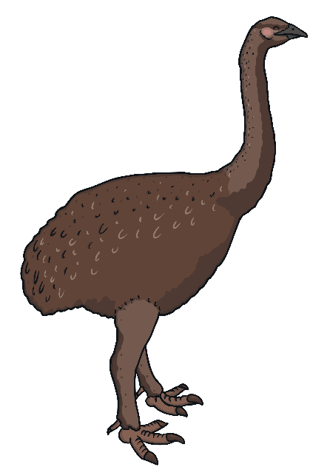
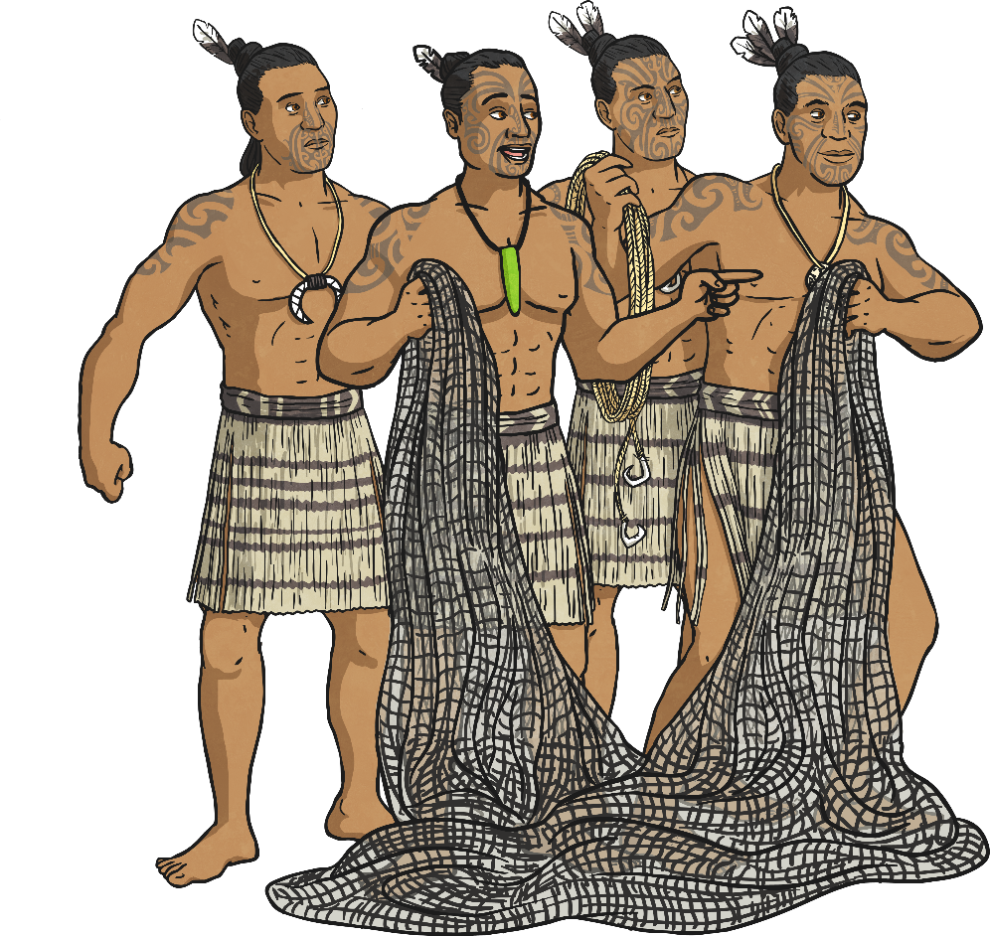
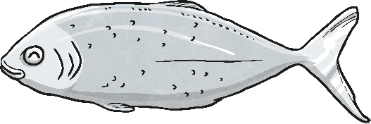
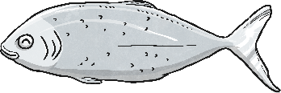
Māori Life
The Māori people were hunter gatherers.
Food was often gathered and hunted from the land
and sea. The Māori people mainly survived on a
diet of a huge flightless bird called a moa.
The Māori people hunted this bird and it is now extinct.
They also spent a lot of time fishing. Their food was usually cooked on a large heated stone. Some fish was eaten raw. Some of the seafood they
caught was used for trading.

Slide 4
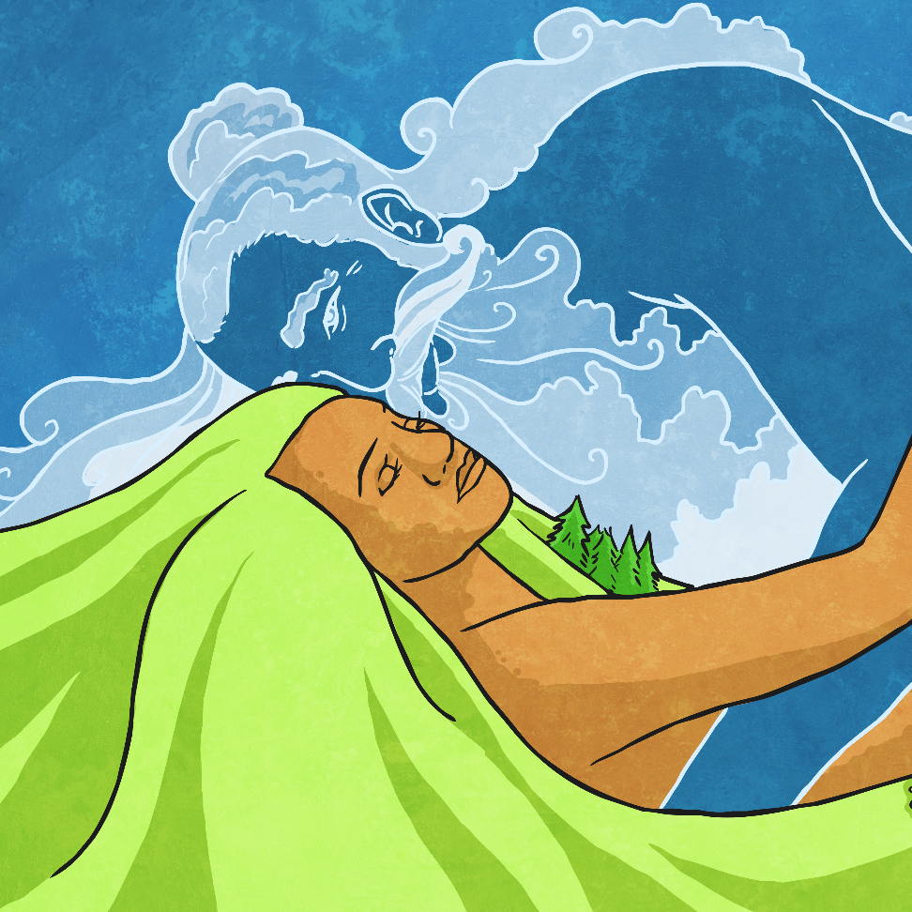
The Māori People and Their Beliefs
The Māoris have deep spiritual beliefs.
They believe in gods which
represent sky, earth, forests and
forces of nature. They have deep
beliefs in the spirits of their
ancestors. The Māori people
believe that they can call upon
their ancestors in times of need.

Slide 5
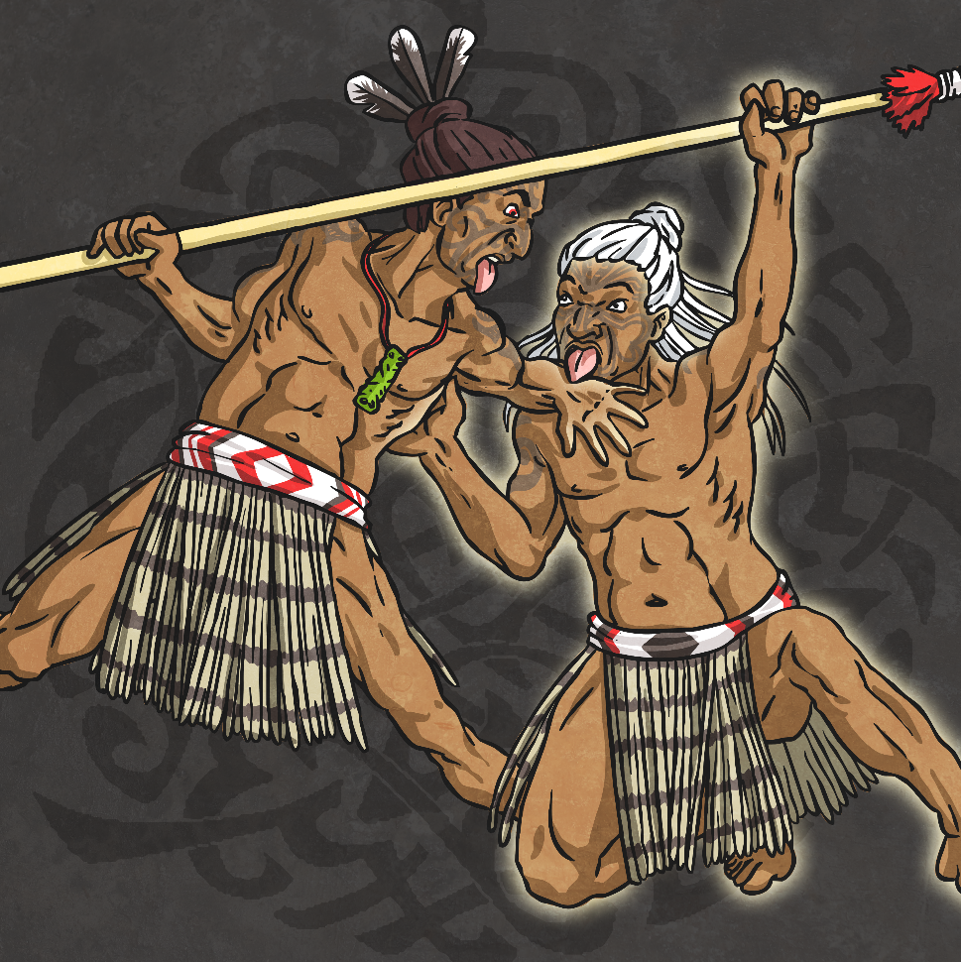
Māori Culture and Traditions
The Haka
A well-known Māori cultural activity is
the Haka. The Haka is a ‘war dance’.
It is a chant which involves lots of
hand gestures and foot stamping.
Facial expression is also very
important in the performance of
the Haka.
It was originally performed by
warriors before a battle.
Now, it is performed by the
New Zealand rugby team before a game.

Slide 6
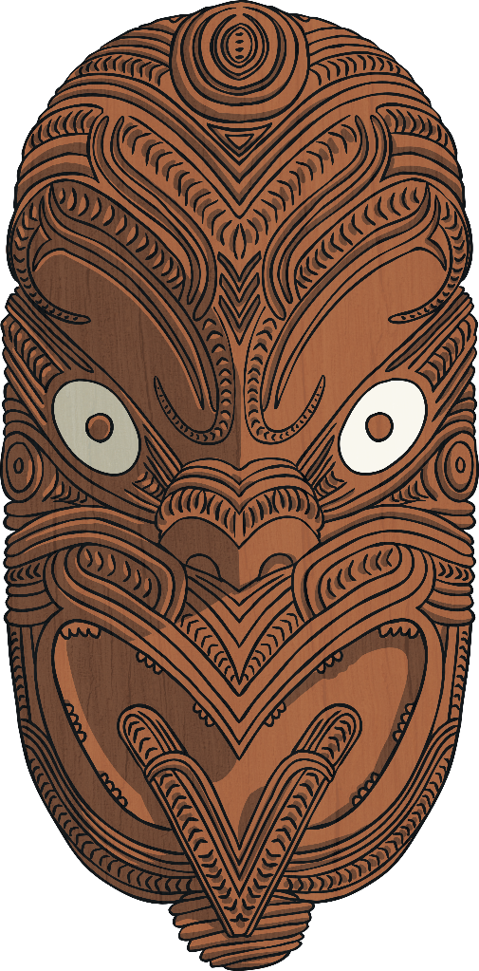
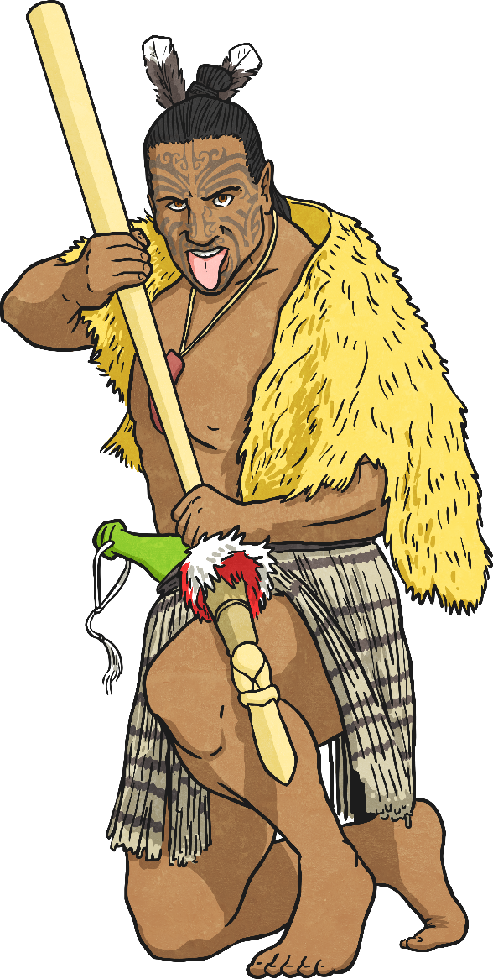
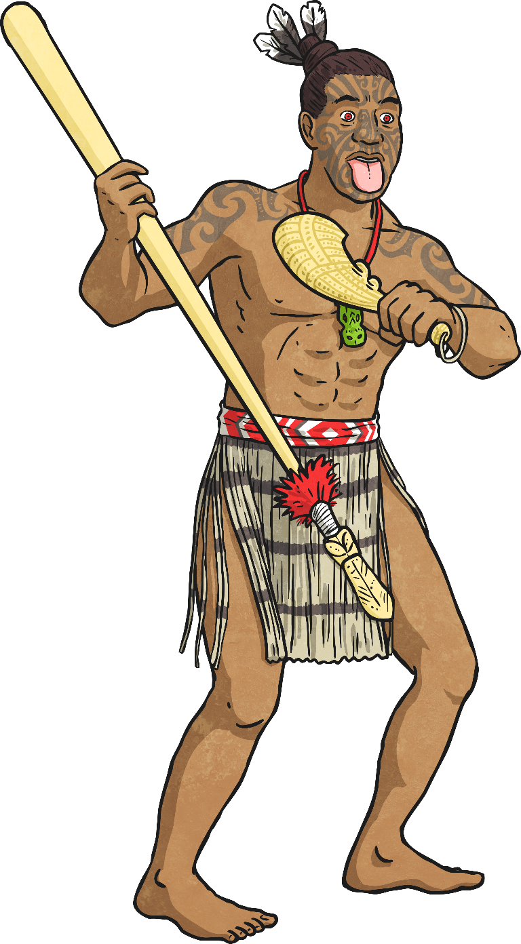
Māori Culture and Traditions
Wood Carvings
Māori masks are made through carving pieces of wood.
The masks are designed to look vicious, with
aggressive expressions. The lines on the masks are
designed to mirror Māori facial tattoos. Facial tattoos
were worn to look ferocious and scare off enemies.
Today, some Māori people have facial tattoos to
preserve the culture of their ancestors.

Slide 7
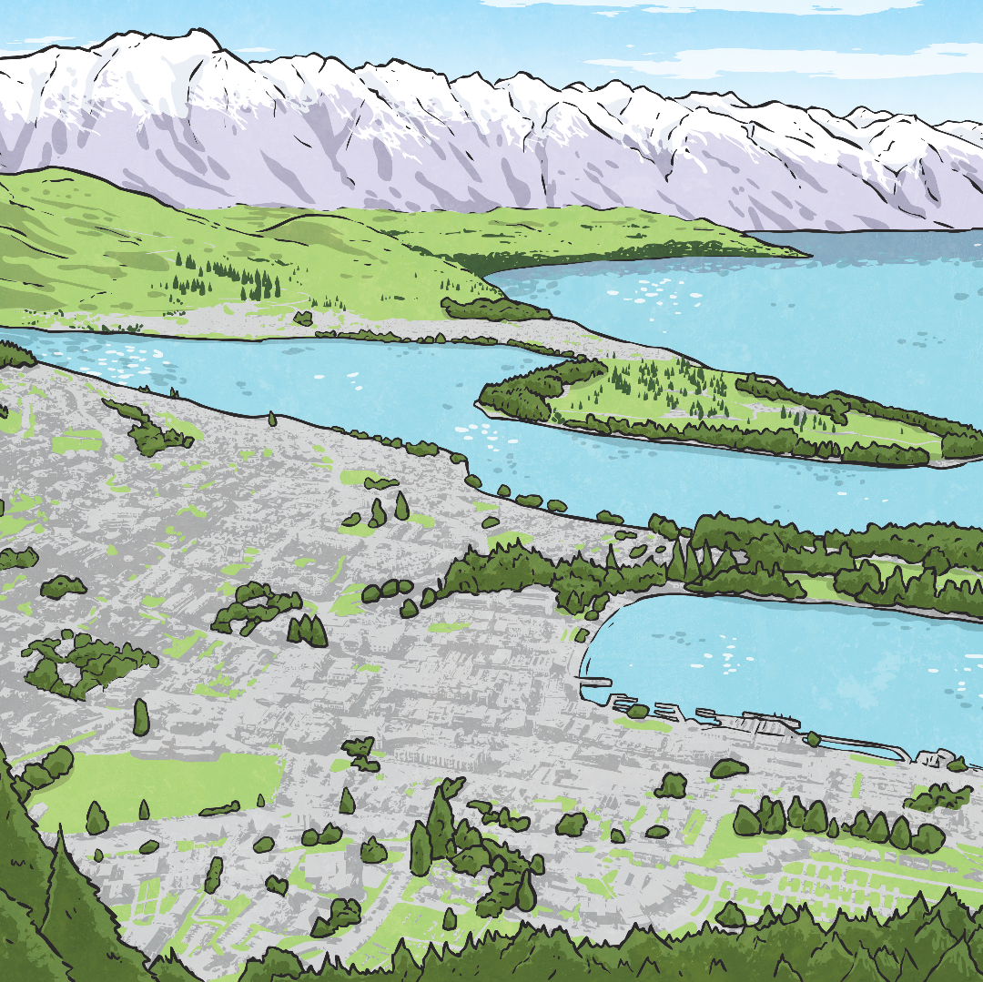
Māori People Today
There are still lots of people who
identify as Māori. Māori songs,
dances, traditions and language
are being taught in schools.
The Māori language, Te Reo,
is an official language in
New Zealand. However, not
many have mastered the
language or use it as their
first language.

